Slide 1
Coursework 2016/17 Steps 2 & 3
and EasyGUI

Slide 2
Step 2
5 marks for this step!
Only two tasks to implement
You have to implement a new method of the Request class called displayRestricted
Exactly the same as displayAll except that it does not display the request ID, student name or password
Ensure that all outputs are correct and properly formatted
Present a uniform user interface (both displayAll and displayRestricted should have a similar user interface)
You also have to create a menu with option – “Create a new request”
Either CLI or GUI

Slide 3
Step 2
Create a copy of Step1.py and name it Step2.py
Create the new displayRestricted method
Change your program code to use the displayRestricted method for output
Change the code of your program such that when the program starts it goes straight to a menu prompt giving the option to create a new request.
Things to consider –
In step 1 did you loop back after each request? If so how will you handle that here?
Although not explicitly mentioned in the project brief, you may want to consider having some means of letting the user quit the program

Slide 4
Example Interface (CLI)
>>>Welcome to UWS Study Buddy App
>>>Press any key to make a new request
>>>Request ID = 123456
>>>input name: John Smith
>>>input password: 77889900
>>>input program: BSc Computer Science
>>>input year of study: 2
>>>input campus: Paisley
>>>input module: Intro to Programming
>>>input available day (9 to quit): Monday
>>>input available time: evening
BSc Computer Science, Paisley
Intro to Programming, Monday: Evening

Slide 5
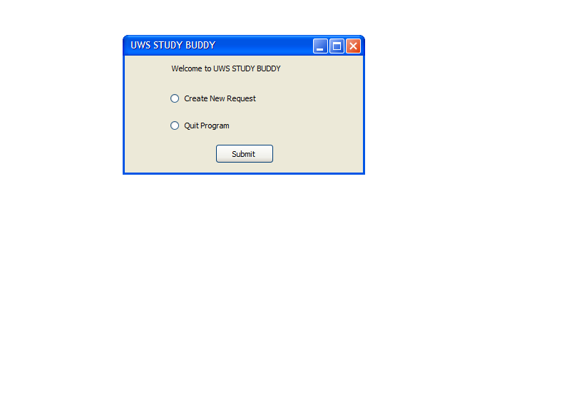
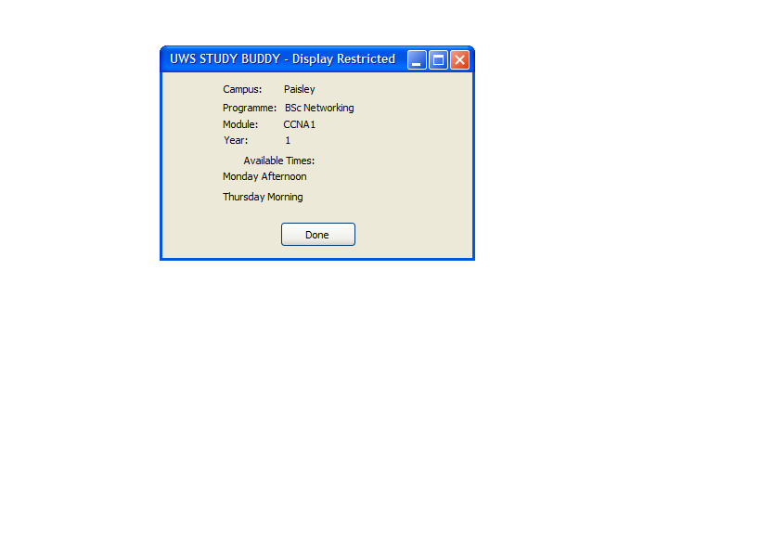
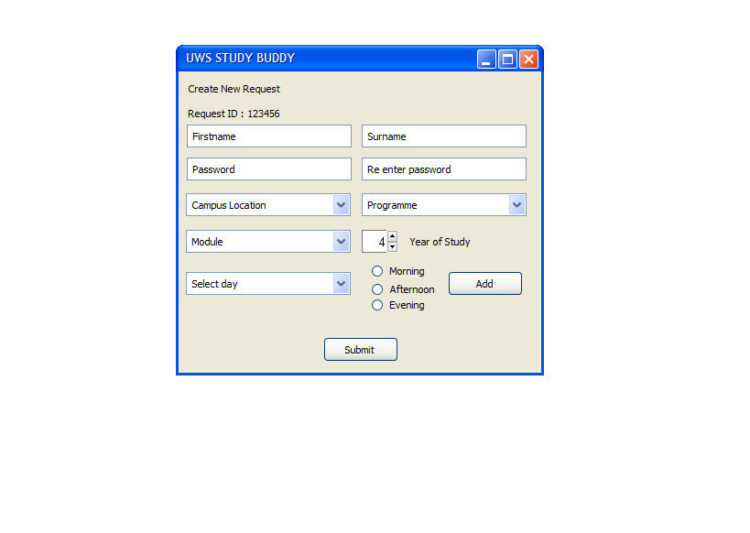
Example Interface (GUI)
Restricted Output Displayed
Same Data Entry Window
New Menu Window

Slide 6
Testing
As with Step1
Create a new folder for step 2
Create a testing plan with sample data and save to the step 2 folder
Take screen dumps as evidence
Save everything (including Step2.py) in the step 2 folder

Slide 7
Step 3
15 marks for this step!
3 main tasks to implement
Provide a function to persistently save a request to a file
Provide a function to retrieve the data from the file
Provide an updated method of ensuring that Request IDs are unique. The method must persistently store the list of Request IDs in a file

Slide 8
Step 3
Persistently store a request (using Pickle)
You will need to create a function to do this.
Pickle can preserve the data and structure of almost any object INCLUDING an instance of a class in a binary file.
Provided you perform the pickle and unpickle operations in your main program, and your class has been declared in the same .py file, this should be straightforward.
N.B. It will NOT be as simple if you perform the pickle and unpickle operations within methods of the request class.
Filename should match request ID. (e.g. filename for request 123456 should be “123456.pck”

Slide 9
Step 3
Retrieve a stored request (using Pickle)
You will need to create a function to do this.
pickle.load will return an object that is an instance of the Request class
filename = “file.pck"
f = open(filename, "wb")
pickle.dump(obj, f)
f.close()
filename = “file.pck"
f = open(filename, "rb")
retrieved_data = pickle.load(f)
f.close()
Persistently store obj in file.pck
Retreive stored obj in file.pck to variable retrieved_data – it will have same data structure as obj

Slide 10
Step 3
Persistently maintain a list of currently used request ID’s.
Updates the function in step 2 that tracks and verifies request ID’s
Project brief says use a text file (Request.txt) but you can used a pickled file if you wish
As with step 1 generate a random six digit ID.
Instead of directly using a list in memory, read in the list of current ID’s from the file into a list. (N.B. this requires that a file exists and is not empty if you use pickle).
Compare new request ID to list, if found – not unique – get a new ID and try again
Repeat until unique ID found – update list with new ID and write back out to file
Proceed as per step 2

Slide 11
Easy GUI
If you have time!
And you find TKinter a bit hard!
Easier to use – faster development times
- no need to worry about handling events
- not as feature rich, but sufficient for most small applications
Documentation at http://easygui.readthedocs.io/en/master/index.html
To install the package-
From the Windows or Linux Command Prompt
pip install --upgrade easygui

Slide 12
Easy GUI – A simple example
import easygui
# Create a window with three buttons and return the value of the chosen button to the variable favourite
favourite = easygui.buttonbox('Click on your favourite module.', 'Favourite Module', ('Systems', 'CCNA', 'Programming'))
# Create a message box to display the user's choice (from the previous window)
easygui.msgbox(favourite, 'Your Choice')
As you can see easyGUI is significantly less complex than TKinter

Slide 13
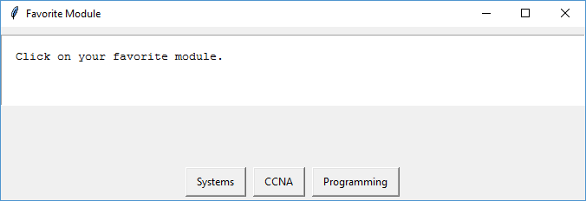
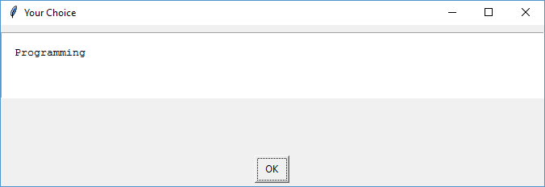
Easy GUI – An example
easygui.buttonbox
easygui.msgbox

Slide 14
Easy GUI – An example
We can also pass variables to easygui widgets
from easygui import *
title1 = "Favourite Module"
title2 = "Your Choice"
bodytext1 = "Click on your favourite module"
buttons = ['Systems', 'CCNA', 'Programming']
favourite = buttonbox(bodytext1, title1, buttons)
msgbox(favourite, title2)

Slide 15
Window Title – Arg #2
Body text– Arg #1
Button text– Arg #3 – a list or tuple can be passed
Window Title – Arg #2
Body text– Arg #1 N.B. We passed a variable this time
Button text– Arg #3 –OK is default button for message box
Generic form easygui.widgetname(arg#1, arg#2, arg#3,…..)

Slide 16
EasyGUI
The downside – not as flexible as Tkinter
Not simple to build a window containing multiple components, you still need Tkinter for this!
Lots of widgets available (see EasyGUI documentation online)
Button Boxes including Message Box, yes/no box ……..
Choice Box and multchoice Box when you want to choose one (or more items from a list)
Data entry Boxes including entry box multentry Box and integer Box
Text Boxes to display output
And a few more………

Slide 17
Examples Programs
The following example programs illustrate step 3 using a simple CLI implementation and a easyGUI implementation

